Slide 1




Hackathon Registers of Cultural Entities
Reprex non-competing pitch

Slide 2






Reprex: Slovak Cultural Dataspace
No statisticaly valid data
You cannot send a survey questionnaire if you do not know who should get it.
No coordination of treasures
You cannot lend books across libraries because they do not know other libraries and cannot send a copy there.
Low visibility & efficiency
It is impossible to support the visibility and popularity of Slovak cultural products if you do not know whom to support.
No policy control
The Slovak state, regional and municipal bodies do not know who needs to be helped.
No business controlling
Cultural institution managers do not know if they are doing a good or bad job, no clear comparisons.
No cooperation
If you do not know the other peers, then you cannot solve problems together.

Slide 3
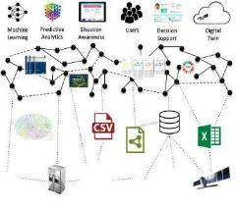
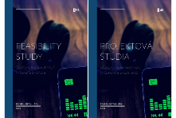

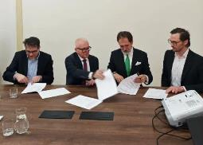
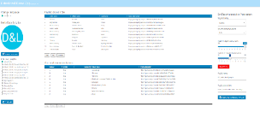






Building the Slovak Music Dataspace
Reprex: Slovak Cultural Dataspace
We realised these problems in the Slovak Music sector and we are close to a comprehensive solution
2020
2020
2021-2022
2023
2024
First quantitative data mapping of the Slovak music industry; first in-depth CCI report in Slovakia with extensive data collection.
Feasibility Study: Identification of serious data problems, demo version of the Slovak Comprehensive Music Database with a registry.
Listen Local App Demo Various data collections
Open Music Europe Horizon Europe project
Memorandum of Understranding Cultural ministry, IKP, EUBA, Reprex, SOZA & Consortium
Slovak Music Dataspace Wikipedia/Wikidata
Extendible via federation to many countries in Europe

Slide 4



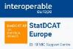
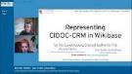





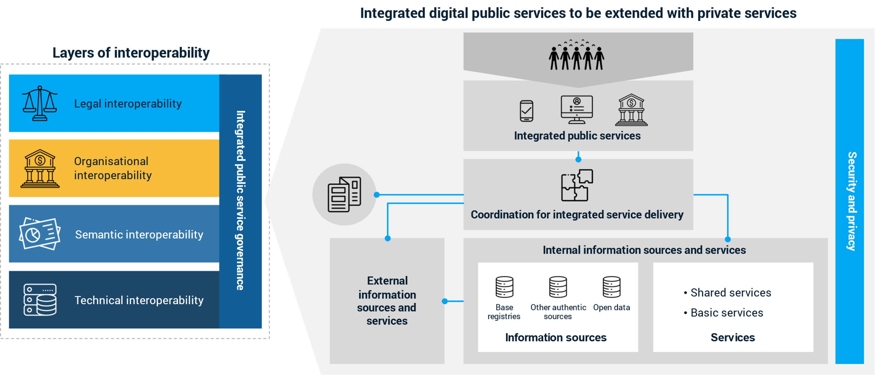
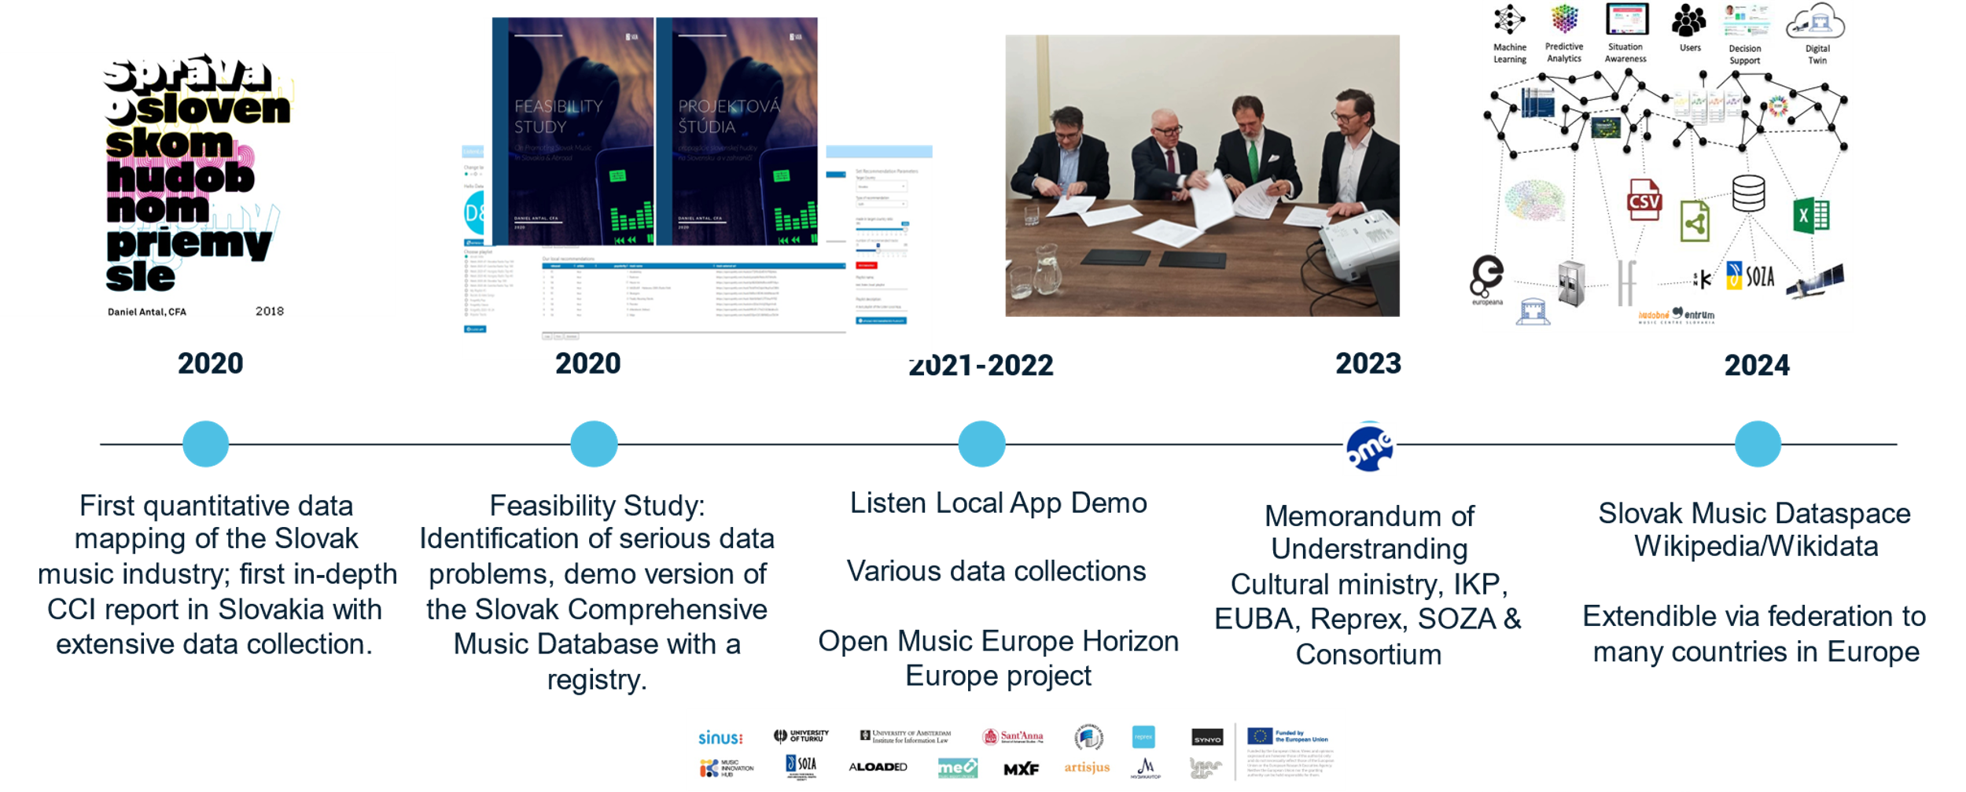

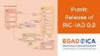

We considered the best practices in the world
Reprex: Slovak Cultural Dataspace
We build a system from the best information (conceptual) models and open-source linked database components
Satellite Business Registers
Luxembourg Shared Authority File + Wikibase
EU Open Data Portal
Statistical Data & Metadata eXchange
Cultural Information Models
European Interoperability Framework
BVDA/Gaia-X Data (Sharing) Space
EU Open Data Portal

Slide 5





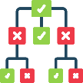


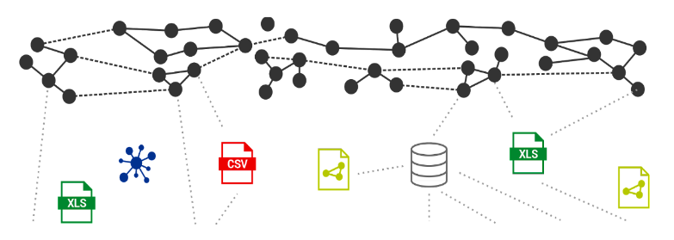













Slovak Music Dataspace
Reprex: Slovak Cultural Dataspace
Slovak Cultural Dataspace
Application layer: Listen Local Apps for radio or educational playlist editing. Name Entity Matching and Name Entity Disambiguation for rights management.
Semantic layer: data coordination among public, private, local and international data owners.
Database layer: databases of participating organisations, shared only as needed and as permitted.
Collection layer: data collection internally (existing databases, registers, membership lists) and external data sources.
Machine Learning
Artificial Intelligence
Users
Applications
Decision Support
Digital Twin

Slide 6
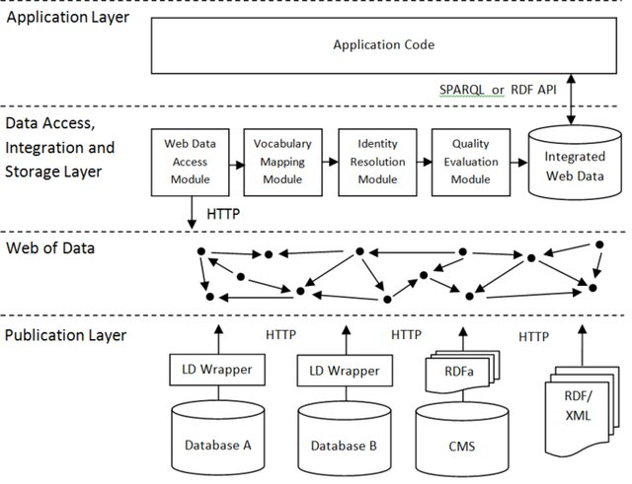









System Components
Open source software and interoperable, open information models
Linux/UNIX
Apache Webserver
MediaWiki
PHP
Wikibase
MariaDB

Slide 7
We are able to meet most requirements in the first 2 months
Reprex: Slovak Cultural Dataspace
Most features will be available in the first months, some will be deployed around M3 or later
Public and private sections | We create a private Wikibase instance with strict hierarchical administration, and train ministry administrators.
Automated data collection | We start first with automated data collection in music, and gradually extend the scope to other sectors.
Manual registration of entities | Manual data entry will be possible from deployment day.
Categorization of entities by cultural sectors | We will create an initial taxonomy that we will align with international ontology standards in several iterations.
Import and export of data | Initially we support Excel, CSV, RDF, export/import, and import from music databases. In subsequent months we build tools for existing fixed-schema RMDBS systems in SQL as needed.
Output data for managerial decision-making | Managerial decisions data will be available once the system is reasonably well populated, around M3.
Dynamic pages, widgets | Dynamic pages, dashboards, widgets can be developed in early phases but we believe that sufficient experience with managerial data is needed to design lasting, user-friendly dynamic applications.
Automated processing of statistical results | Our systems use the novel EU/UN methodology for extending official governmental statistics with satellites. We create “official” quality statistical output with our own peer-reviewed, open-source software.
Trustworthy AI | Our system works as an explicit knowledge base (as defined by the EU AI Act) and we extend its functionality with trustworthy AI functions to improve data quality and knowledge coverage.
Source: Based on open call
Phase 1
Phase 2
Phase 3
Phase 4

Slide 8
System is usable in about 12 weeks and extendible with new services
The most resource-intensive tasks are workflow planning, education, onboarding, the system itself is made of open-source components that are widely used worldwide for similar problems.
1. System Deployment
1.1. All data recording, exporting functions work; dedicated cloud server or local server
1.2. Internationally interoperable taxonomy for organisations
1.3. Automated import from Ministry of Culture, music works, Wikidata, VIAF
2. Maintenance workflow and training
2.1. Training registry administrators for onboarding new organisations
2.2. Defining management information outputs
2.3. GDPR and data protection training, legal interoperability
2.4. Onboarding case study with one cultural field (for example, libraries)
3. Onboarding and partner organisation education
3.1. Onboarding more and more private registries, or other public registries
3.2. Importing historical data for comparison and change tracking, ideally since 1993
3.3. Writing open-source connector to legacy systems, partner cultural organisation systems
3.4. Web-scraping information
4. Application development
4.1. Onboarding more and more private registries, or other public registries
4.2. NER, NED entity, link matching with machine learning and deductive engines
4.3. Statistical application that crates satellite statistics (well aligned with KULT microdata)
4.4. Dynamic dashboards
2 weeks
4 weeks
12 weeks
12 weeks

Slide 9
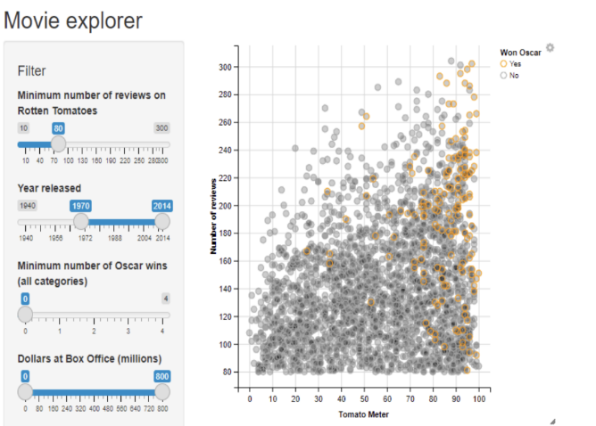
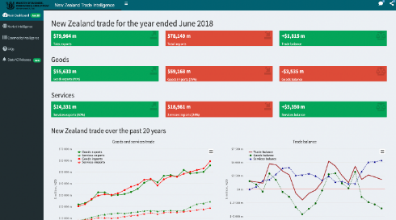





Shiny Apps & Dashboards
Reprex: Slovak Cultural Dataspace
Shiny Apps are extending the popular, open-source R statistical environment and they can be deployed in hours.
Reprex developed several official extensions to this globally used system; some of them were developed with Slovak data.

Slide 10
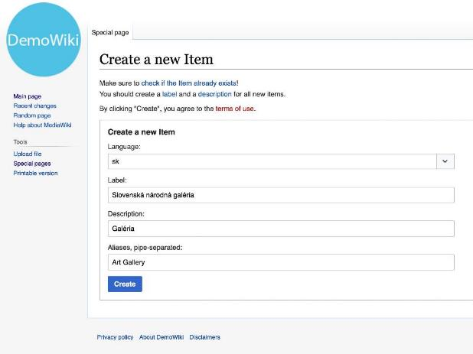
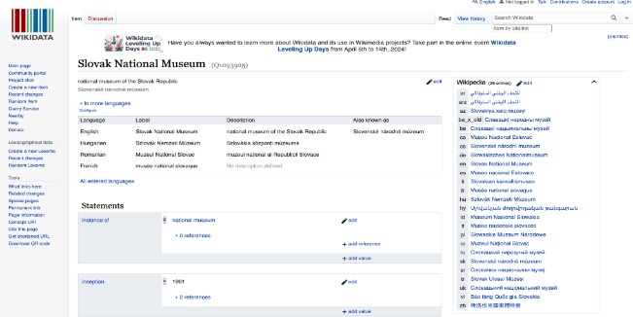
Well-known, easy to use GUI
Reprex: Slovak Cultural Dataspace
Wikidata and Wikipedia were designed for citizen scientists and

Slide 11
Value proposition
Reprex: Slovak Cultural Dataspace
A.
Ready to deploy in a month
B.
Open source, open knowledge, modular,
trustworthy AI
C. Sound data coordination and validation workflows used in other countries

Slide 12
Ready to deploy in a month
Reprex: Slovak Cultural Dataspace
Open-source solutions have a very high Technical Readiness Level, and deployment in music is already under way with much more granular data
A.
Ready to deploy in a month
Very fast deployment
Our system is modular and uses trusted open-source systems that other EU member states use for similar purposes. We will launch our music dataspace in June, and it can include other sectors from Day 1.
Our legal interoperability model can be used in other sectors, can go well beyond the needs of this hackathon objectives.7.3.

Slide 13
Open for collaboration with other hackathon contestants
Reprex: Slovak Cultural Datasapce
We use only transparent, open-source solutions, which are easy to replace or fix, and non-sensitive data can be synchronized with public knowledge systems like Wikipedia
Open Collaboration model
We have designed our solution for open collaboration from the onset, and prepared a cooperation with Wikipedia Slovensko and the Wikipedia Foundation.
Because we are working in open collaboration, we can host the solutions of other competing teams!
Algorithm only uses verifiable, trustworthy, explicit knowledge, no black box guesswork.
B.
Open source, open knowledge, modular,
trustworthy AI

Slide 14
Sound data coordination and validation workflows used in other countries
Reprex: Slovak Cultural Dataspace
Introduce the European Interoperability Framework into the cultural organisations of the Slovak Republic, extending the data standards to non-state entities like art galleries or orchestras, too
C. Sound data coordination and validation workflows used in other countries
Internationally interoperable worfklow
Our system automates data collection, data exchange and validation workflows that are considered valid and sound by statistical authorities, international museum and heritage organisations, libraries, and other domain-specific standards. We know how to translate their knowledge into the ministry’s data systems in the correct form and semantic meaning.

Slide 15



Thank you for your attention
Questions? Get in touch:
reprex.nl/contact www.linkedin.com/in/antaldaniel

Slide 16


Background information not part of the pitch!
From the Slovak Comprehensive Music Database to a federated cultural data sharing space
2024.04.11.

Slide 17
Problems with data
01 Problems with ddata
01

Slide 18



Hackathon - Registers of Cultural Entities
Case: Real-life sanitized example #1
Initial Situation
The Ministry of Culture of the Slovak Republic does not have a register of all existing legal entities in the field of art, culture, and the creative industries, making it difficult to implement measures aimed at the entire sector. Its significance became fully apparent after the outbreak of the Covid-19 pandemic when the ministry needed to target governmental support, but it did not have a complete list of eligible entities
Existing registers
Sectors of cultural heritage (museums, galleries, libraries) – nearing 100% repletion
Art sector (visual arts, theaters, musical entities) – low repletion
Sectors falling under KKP (architecture, design, gaming industry) – no registers
Expected solution
A method of creating an information system (IS) that will contain registers of legal entities whose main activities have an artistic or cultural character, as well as the method of filling it with data and how to obtain, process, and display this data.
Source: [Sanitized]

Slide 19
History of Innovation in Slovakia
02

Slide 20
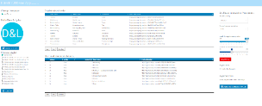
Building the Slovak Music Dataspace
02 Vision & Ambition
Our roadmap is replicable, but requires many conversations that build trust among institutions
2020
2021-2022
2023
2024
2025
Feasibility Study: how to support the policy goals of the local content regulations (from radio to streaming) to support the local music ecosystem. Identification of serious data problems.
Listen Local App Demo Various data collections
Open Music Europe Horizon Europe projekt
Memorandum of Understranding Cultural ministry, IKP, EUBA, Reprex, SOZA & Consortium
Slovak Music Dataspace Wikipedia/Wikidata
Extendible via federation to many countries in Europe
Listen Local app for radio and streaming playlisting HearDis! in-store demonstration
Unlabel label services for the unlabeld

Slide 21
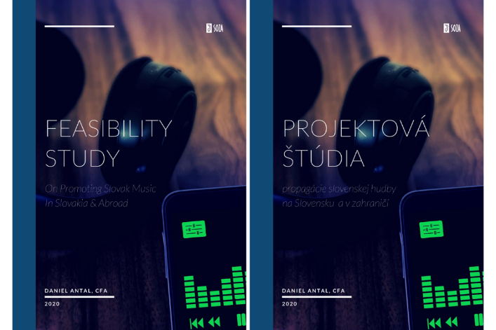
Sustainability
001 Problems with ddata
Why do they not recommend music from Slovakia in Slovakia for Slovak people?
How can we avoid that small repertoires lose their original market, their only market?
Findings
Small repertoires have very low-quality data representation
Because of low income, data improvement and documentation must not be expensive
Public-Private Partnership is needed to solve data problems

Slide 22
Building blocks: the best practices
03

Slide 23
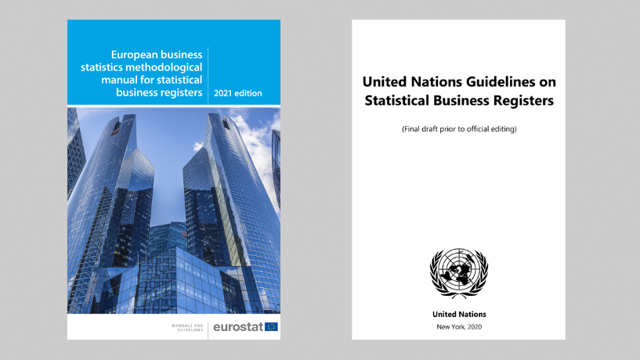
Satellite Business Registers
New methods and regulations to allow the coordination of state statistical registers with privately-held registers, such the registers of SOZA or the chamber of architects

Slide 24

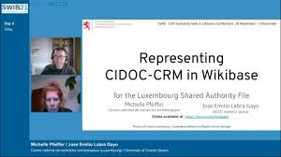

The Luxembourg Shared Authority File & Wikibase

Slide 25

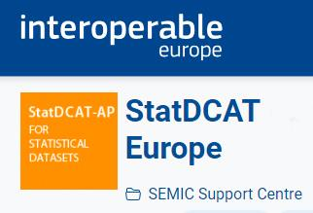

EU Open Data Portal, Statistical Data & Metadata eXchange
DCAT-AP and its statistical modification

Slide 26

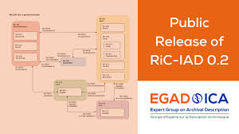
Cultural Information Models
In the European cultural sector, the Europeana Data Model is a de-facto interoperability minimum standard, with museums and national archives using more complex conceptual models

Slide 27











Embracing the European Interoperability Framework
04 Data coordination & interoperability
Extending the interoperability of digital services among public and private parties
Integrated digital public services to be extended with private services
Layers of interoperability
Legal interoperability
Integrated public services
Organisational interoperability
Coordination for integrated service delivery
Integrated public service governance
Security and privacy
Semantic interoperability
External information sources and services
Internal information sources and services
Technical interoperability
Information sources
Services
Shared services
Basic services
Base registries
Other authentic sources
Open data

Slide 28


BVDA/Gaia-X Data (Sharing) Space
A novel legal, organisational and technical institution introduced by the Data Governance Act, and developed by Gaia-X and the Big Data Value Association for the EU and its member states

Slide 29
Our solution: Slovak Cultural Dataspace
04

Slide 30



Slovak Cultural Dataspace
Our solution: Slovak Cultural Dataspace
Maintainance process
A strong business process that ensures all data is found and updated when changes happen; proper information model to automate the process.
Knowledge graph with database GUI
We build on Wikibase, a graph database of Wikipedia, because it is aimed at citizen scientist level, and has an intuitive GUI.
Apps for Analysis, Export/Import
We create dashboards, statistical applications, and export import tools to/from Excel, CSV, SQL and RDF.
Achieve strong, long-term future-proof solution
Source: [Sanitized]

Slide 31
Implementation Phases
Our solution: Slovak Cultural Dataspace
System setup Business definition M1
Information model
Onboarding
From M2
Scale up and enrich
From M3
1 month
1 month
1 month
System improved at user’s pace
Business process Define the business process, and derive the supporting information model for high level of automation. The information model contains taxonomies of entities.
Slovak Shared Authority File: Wikibase with authority control
We adapt to Slovak institutional framework the Luxembourg Shared Authority File
Maintainance Maintenance can include the iinclusion of new data, definition of new dashboard items, visualisations
Information model Ontology and data scripts (OWL/RDF/R) to for automated data maintenance
Manual oversight and manual entry Simple, widely used GUI with plenty of Slovak, English documentation: Wikipedia
Pre-population with current and historical data To initiate the change management, we will upload past data whenever possible since 1993.
Source: xx

Slide 32
Music Data Space
Our solution: Slovak Cultural Dataspace
A data (sharing) space is a legal, technical, organisational solution to trustworthy public-private data sharing.
Trustworthy public-private data sharing is essential to solve big data problems like ESG reporting or trustworthy AI.
Reprex is associated with the Big Data Value Association and follows its data (sharing) space model.
As a member of the Dutch AI Coalition, we are committed to building trustworthy AI applications.
DATA
GOVERNANCE
ERP, database
External (outside organisational boundary)
Trustworthy procedures
Retain data trustworthiness
TECHNOLOGY
PEOPLE
Explicit knowledge base
Data coordination
Match prediction
Internal data users
Assurance users
Regualatory users
ORGANISATION
Harmonised business processes
Human-on-the-loop

Slide 33

Slovak Cultural Dataspace
Our solution: Slovak Cultural Dataspace
Application layer: Listen Local Apps for radio or educational playlist editing. Name Entity Matching and Name Entity Disambiguation for rights management.
Semantic layer: data coordination among public, private, local and international data owners.
Database layer: databases of participating organisations, shared only as needed and as permitted.
Collection layer: data collection internally (royalty accounts, work registers) and external data sources.
Machine Learning
Artificial Intelligence
Users
Applications
Decision Support
Digital Twin

Slide 34
From the Slovak Music Dataspace to a federated cultural data space
Our solution: Slovak Cultural Dataspace
Scalable national interoperability system using the infrastructure of the Slovak Music Dataspace
Via data federation we can add the gaming industry, galleries, libraries, museums, cinemas, theatres….
We are fully interoperable with European initiatives
European Cultural Heritage Cloud
Slovak Music Dataspace
Slovak Cultural Dataspace
Slovak Cultural Dataspace
AV database
IKP files
Library systems
EU Open Data Portal
The Slovak Music Datapsace connects the databases of SOZA, Hudonbné centrum, Hudobny Fond, Wikidata, Wikipedia, MusicBrainz and other international sources.
The data federation model of dataspaces allows onboarding the entities of other cultural sectors with no significant added cost.
Our model follows the European Interoperability Framework and connects seamlessly with EU data integration projects.

Slide 35
Features
04

Slide 36
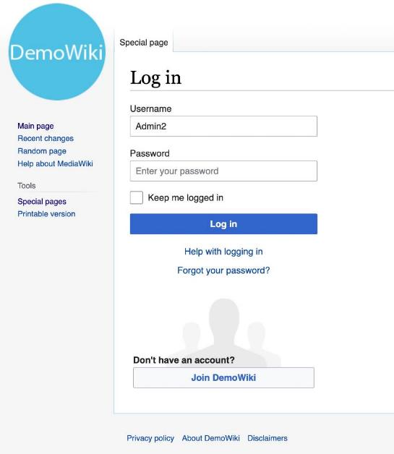
Public and private sections
We create a private Wikibase instance with strict hierarchical administration, and train ministry administrators.

Slide 37

Automated data collection
We start first with automated data collection in music, and gradually extend the scope to other sectors.

Slide 38
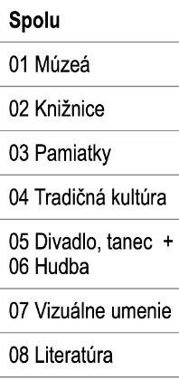
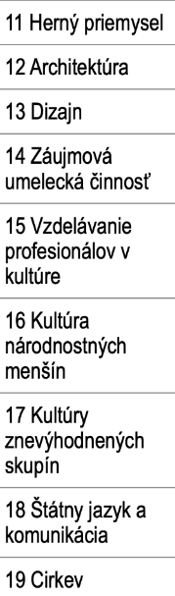


Automated data collection
We start first with automated data collection in music, and gradually extend the scope to other sectors.

Slide 39

Manual registration of entries
Manual data entry will be possible from deployment day.

Slide 40
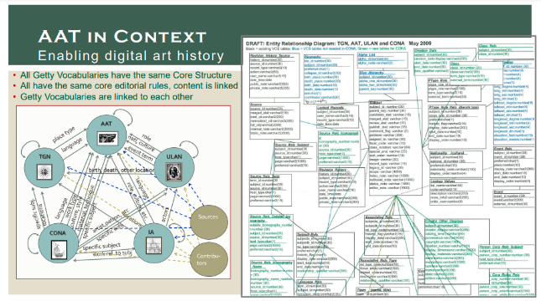
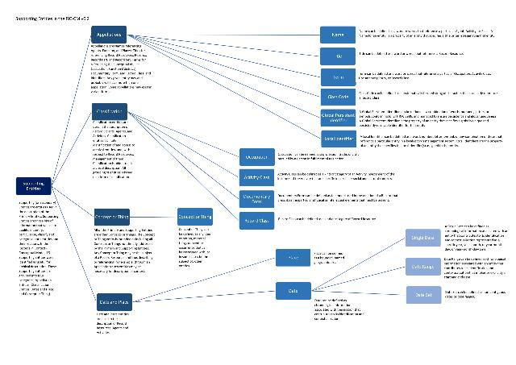
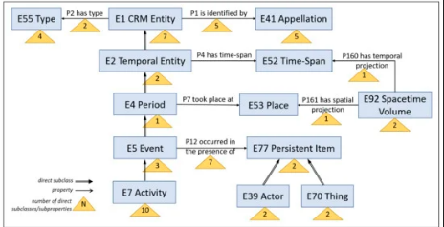
Categorization of entities by cultural sectors
We will create an initial taxonomy that we will align with international ontologies and thesauri, such as AAT, RiC, CIDOC, statistical taxonomies that provide a full interoperablity with existing state registries, international data, and existing museum, library and gallery management systems.

Slide 41





Import and export
Only schematic reference to XLSX, CSV, SQL database, RDF graph, even with icons
Initially, we support Excel, CSV, RDF, export/import, and import from music databases. In subsequent months we build tools for existing fixed-schema RMDBS systems in SQL as needed.

Slide 42

Generation of output data for managerial decision-making
Managerial decisions data will be available once the system is reasonably well populated, around M3. They will be placed in to Shiny Apps, and training will be provided for their long-term customisation.

Slide 43

Dynamic pages & dashboards
Dynamic pages, dashboards, widgets can be developed in early phases, but we believe that sufficient experience with managerial data is needed to design lasting, user-friendly dynamic applications.

Slide 44



Automated statistical processes
Our systems use the novel EU/UN methodology for extending official governmental statistics with satellites. We create “official” quality statistical output with our own peer-reviewed, open-source software.

Slide 45
Features
Risks and mitigations
Overview of system features
Public and private sections | [Description of risk]
Automated data collection | [Description of risk]
Manual registration of entities | [Description of risk]
Categorization of entities by cultural sectors | [Description of risk]
Import and export of data | [Description of risk]
Generation of output data for managerial decision-making | [Description of risk]
Creation of galleries, navigation menus, dynamic pages, and widgets | [Description of risk]
Automated processing of statistical results | [Description of risk
Source: Based on open call

Slide 46

Futureproof interoperability solutions
WP2 Planned Applications for Exploitation
We are creating future-proof systems that can regenerate themselves. We create databases that contain the detailed and standardised knowledge on how to build up a database application that can import and use their data. We can provide support for inherited legacy systems, and make them future-proof. We want to avoid to create the next decade’s legacy systems with utilising the world wide web / ISO RDF standards to describe data, metadata and knowledge to use them.
Illustrations: .伊勢神宮 Ise Grand Shrine, which had been rebuilt about every 20 years in the last 1600 years from its components.

Slide 47

Capitalizing on open knowledge and open science
05 Data-to-policy: evidence-driven green supply chain and procurement management
Reprex creates open-source scientific components
to be used in business application with SGD impact
Reprex creates extensions to the R Statistical Environment and Language, which is used in most statistical agencies and statistics-based scientific research organizations. Our key components go through scientific and data science peer review, and the facilitate public data access, coding, environmental and social impact calculations with approved EU/UN methodologies.
Public
P
We build our proprietary Eviota components in OWL/RDF/R to enable private partners to efficiently integrate trustworthy data from public sources (statistical, meteorological, environmental satellite…) with private data vendor, internal bookkeeping, ERP, and credit application/monitoring data.
P
Private
We offer more than a decade of experience in data partnerships that bridge organizational boundaries, public and private sector, and manage conflicts of interests, because in terms of big data, all corporations, state bodies and research universities are small.
P
Partnership

Slide 48
Trustworthy AI
05

Slide 49

Knowledge-base design
04 Data coordination & interoperability
Our overall aim is to show that we can locate more useful data and via increased.
Reprex utilises eXtreme Design, a UX-infused ontology pattern design method for interviewing internal and external stakeholders to set information needs, knowledge base competencies, and functional requirements for our new code.
The eXtreme Design method helps to translate the non-technical expectations of ministry analysist into technical specifications for software and AI.
With the help of eXtreme Design we can design those information model patterns and software patterns that solve repeting problems. This ensures that the new registry will have the right data from the correct sources in the right form.

Slide 50
Extension to inventory management
06

Slide 51
Public-Private Partnership for trustworthy music data
04 Data coordination & interoperability
We create data (sharing) spaces that not only follow the architecture of the European Interoperability Framework but extend the use of these interoperability standards among private partners
Open Science
Many disciplines study music, including in Open Music Europe, and we would like to reuse their data. We see the reuse of information models and ontologies for metadata improvement the most promising, because ontology development is more suitable for basic research than business.
Open Science
Coordination of privately-held and public sector data
The Data Governance Act and various statistical regulations allowing novel data coordination between privately-held and governmental data. We want to facilitate “experimental statistics” and novel music library products to help metadata-poor rightsholders to become competitive in the digital space.
Public sector information reuse (open data)
The Open Data Directive (2019/1024/EU), the Data Governance Act (2022/868/EU) gives legal access to much data for free or at marginal cost, however, these valuable data assets need to be reprocessed to be useful for the music sector.
Collective management, publishers, labels, “Unlabel”
Public sector information reuse

Slide 52
From the Slovak Music Dataspace to a federated cultural data space
Our solution: Slovak Cultural Dataspace
Scalable national interoperability system using the infrastructure of the Slovak Music Dataspace
Via data federation we can add the gaming industry, galleries, libraries, museums, cinemas, theatres….
We are fully interoperable with European initiatives
European Cultural Heritage Cloud
Slovak Music Dataspace
Slovak Cultural Dataspace
Slovak Cultural Dataspace
AV database
IKP files
Library systems
EU Open Data Portal
The Slovak Music Datapsace connects the databases of SOZA, Hudonbné centrum, Hudobny Fond, Wikidata, Wikipedia, MusicBrainz and other international sources.
The data federation model of dataspaces allows onboarding the entities of other cultural sectors with no significant added cost.
Our model follows the European Interoperability Framework and connects seamlessly with EU data integration projects.

Slide 53
Embracing the European Interoperability Framework
04 Data coordination & interoperability
Extending the interoperability of digital services among public and private parties
Integrated digital public services to be extended with private services
Layers of interoperability
Legal interoperability
Integrated public services
Organisational interoperability
Coordination for integrated service delivery
Integrated public service governance
Security and privacy
Semantic interoperability
External information sources and services
Internal information sources and services
Technical interoperability
Information sources
Services
Shared services
Basic services
Base registries
Other authentic sources
Open data

Slide 54

Legal interoperability: focus on using GDPR in private and public institutions
04 Data coordination & interoperability
Legal interoperability: data input and disclosure output automation (replicable from SOZA)
New instruments: Open Data Directive, Data Govern Act, European AI Act, standardised licenses
Cooperation with BVDA and the Data Space Support Centre
Data protection for personal and business confidential data is standardised by SOZA.
Data needs
Data availability
Legal assessment
Clear and opt-out
Opt-in
Poor metadata that increases business cost
GDPR different use in private and public
Legal reconciliation needs
Define cases with no legal restriction
PR planning for mass opt-in
Uncertain data quality that needs cross-checking
Data collection mandates for private and public differ
Existing consent for SOZA members
Define cases when opt-out is sufficient
Several waves of opt-in campaig
Missing data in SOZA and HC
Is the data available at the other organisations?
Existing public sector obligation of HC
Initiate legal changes
Start rolling out in small scale
Source: European Interoperability Framework and relevant legal instruments

Slide 55

Organisational interoperability: public and private organisations have business processes that help each other
04 Data coordination & interoperability
Organisational interoperability: management control and reporting automation
Reprex is currently mapping CMO, IMIC music information center and IAML music library processes. Further processes can be designed to architecture, game industry, theatre, etc. Institutions throughout the project. Our competent, native Slovak-speaking colleague will assists the ministry for a year to build interoperability with all cultural organisations work-reporting processes.
Service needs
Data availability
Usability & Quality
Reprocess & Enrich
Shared Value
Establishing cost saving potential for new service
Definition of data re-processing needs
Legal reconciliation needs
Use AI to compare and cross-enrich data
Redistribute improved confidential data
Review of currnet data improvement workflows
Data collection mandates different procedures
Existing consent for SOZA members
Reprocess to joint formats
SKCMDb for public use
Review of current missing data filling workflows
Studying data snippets, invaluable data samples.
Identified data problem clusters: ISWC/ISRC matching
Data coordination: joint format definition
Start rolling out in small scale
Source: European Interoperability Framework and relevant legal instruments

Slide 56

Semantic interoperability: public and private organisations share the same understanding of data, metadata, categories
04 Data coordination & interoperability
Semantic interoperability: shared understanding of knowledge, translation among organisations
New instruments: Polifonia Ontology Network, RiC, StaDCAT-AP and other semantic standards
Software is needed to enrich existing datasets with semantics or to export/import to existing formats
We support Excel/CSV, SQL and RDF (graph) formats.
Knowledge needs
Data availability
Usability & Quality
Reprocess & Enrich
Shared Value
Agreement on vocabulary and taxonomy
Different formats and definitions in database
Legal reconciliation needs
Use AI to compare and cross-enrich data
Redistribute improved confidential data in SQL
Meaning of information that is missing
Describe existing data with shared semantics (meaning)
Existing consent for SOZA members
Smart application for NER and NED.
SKCMDb for public use in EU Data Portal and Wikidata (RDF)
Precise knowledge definition of missing information
Describe missiing data to be collected precisely.
Use new software to reprocess data into Wikibase
Data coordination in Wikibase
Start rolling out in small scale
Source: European Interoperability Framework and relevant legal instruments

Slide 57

Technical interoperability: public and private organisations can transform their data into a format that facilitates lossless sharing
04 Data coordination & interoperability
Technical interoperability: open source scripts, software, apps, to download and transform data to correct form
User requirement interviews with Ministry and external data source stakeholders to set functional needs, find data samples for programming, and set Competency Questions for unit testing and application design.
Programming with the re-use of high-quality OWL/RDF (metadata) and R language (data) components
Programming needs
Available components
Usability & Quality
Extend or Create
Shared Value
Competency questions for future unit tests
Prototype software elements with data snippets
Package design: existing or new?
Create tutorials and disseminate data and code
Place new datasets into the observatory
Standardised interviews with data owners
Specify new software development goals
Write unit tests based on CQs
Use new sofware to create datasets
Find new developers to bring our software to the next level
Defining and documenting missing functional requirements
Is our background or other packages serve the needs?
Solve ad-hoc problems with the data
Release new functions in packages
Sinus ISO usability tests
Source: European Interoperability Framework and relevant legal instruments

Slide 58











Slide 60





Slide 61

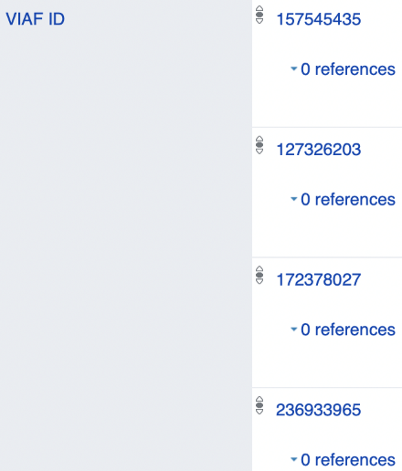



Slide 62








